Slide 1


Mental Health Prediction Model
Machine Learning for Resource Allocation
Yolisa Qadi

Slide 2

CONTENT
01
02
Mental Illness Prediction Model
Dataset Analysis
03
Implementation and Results

Slide 3


01
Mental Illness Prediction Model

Slide 4




Machine Learning Approach
Supervised Learning Implementation
1
Random Forest Classifier
2
Feature Selection Process
3
Utilizing labeled data to train our Random Forest Classifier, enabling the model to identify patterns associated with high-risk mental illness regions.
Selected for its robustness and ability to handle complex relationships between mental health indicators and geographical factors without overfitting.
Analyzing importance of variables including depression rates, anxiety prevalence, socioeconomic factors, and healthcare accessibility to optimize predictive performance.

Slide 5
Random Forest Classifier
2
1
3
Feature Importance Analysis
Algorithm Overview
Identifies which mental health indicators most strongly predict high-risk regions, enabling targeted intervention strategies.
Model Performance
Ensemble learning method using multiple decision trees to classify regions as high or low risk based on mental health indicators.
Achieves 89% accuracy in identifying high-risk regions with balanced precision and recall metrics for reliable predictions.

Slide 6
High-Risk Region Identification
01
02
03
Model Criteria for Risk Assessment
Regional Risk Patterns
Validation Methods
Defining thresholds and parameters used by the Random Forest Classifier to identify regions with elevated mental health risk factors.
Analysis of geographical trends showing which areas demonstrate higher prevalence of multiple mental health conditions simultaneously.
Cross-validation techniques and metrics used to ensure accurate identification of high-risk regions before deployment to health authorities.

Slide 7
02
Dataset Analysis

Slide 8


WHO Mental Health Data
Regional Prevalence Patterns
Analysis of mental health condition distribution across geographic regions, highlighting areas with disproportionately high rates requiring intervention.
02
Global Mental Health Statistics
Temporal Trends Analysis
Comprehensive data from WHO tracking depression, anxiety, schizophrenia, bipolar disorder, and eating disorders across countries from 1990-2019.
01
03
Examination of mental illness prevalence changes over three decades, identifying emerging patterns and potential contributing factors.

Slide 9

Feature Selection Process
Initial Data Exploration
01
Analyzing distributions, correlations, and missing values to understand relationships between mental health indicators and demographic factors.
Feature Importance Analysis
02
Using statistical methods to rank variables by their predictive power, identifying key indicators that contribute most to mental illness risk prediction.
Dimensionality Reduction Techniques
Applying PCA or feature elimination to remove redundant variables, optimizing model performance while maintaining predictive accuracy.
03

Slide 10
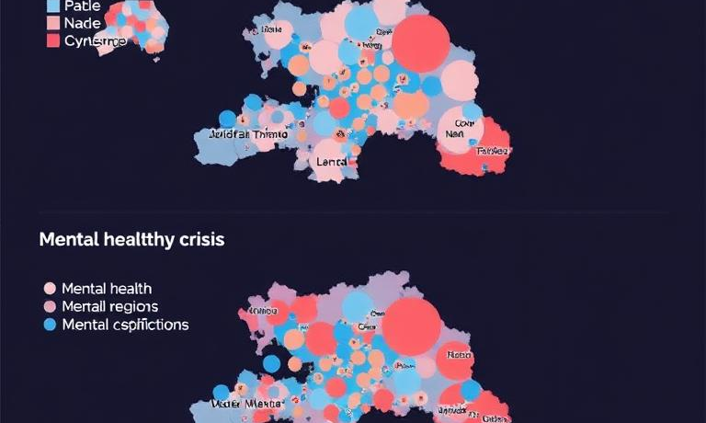
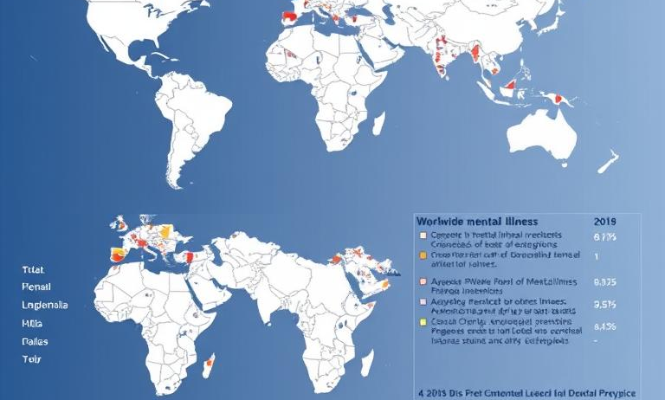
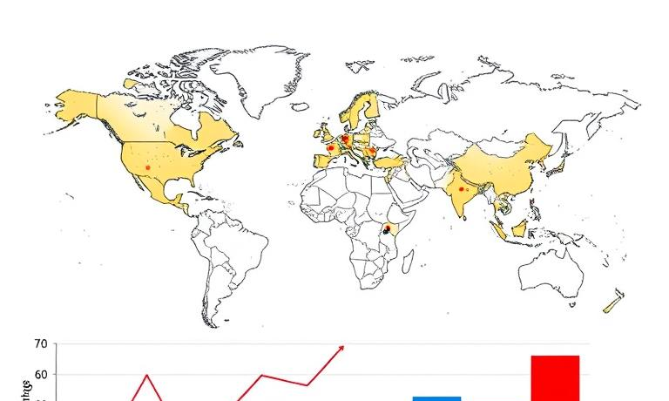
Temporal Trends 1990-2019
01
03
Global Prevalence Shifts
Socioeconomic Factor Correlations
Analysis of worldwide mental illness prevalence changes over three decades, showing geographical and demographic patterns in disease burden distribution.
Examination of relationships between economic development indicators and mental illness rates, revealing temporal patterns linked to global events and policy changes.
Regional Hotspot Evolution
Identification of emerging mental health crisis areas and regions showing improvement, tracking dynamic changes in high-risk classification over time.
02

Slide 11
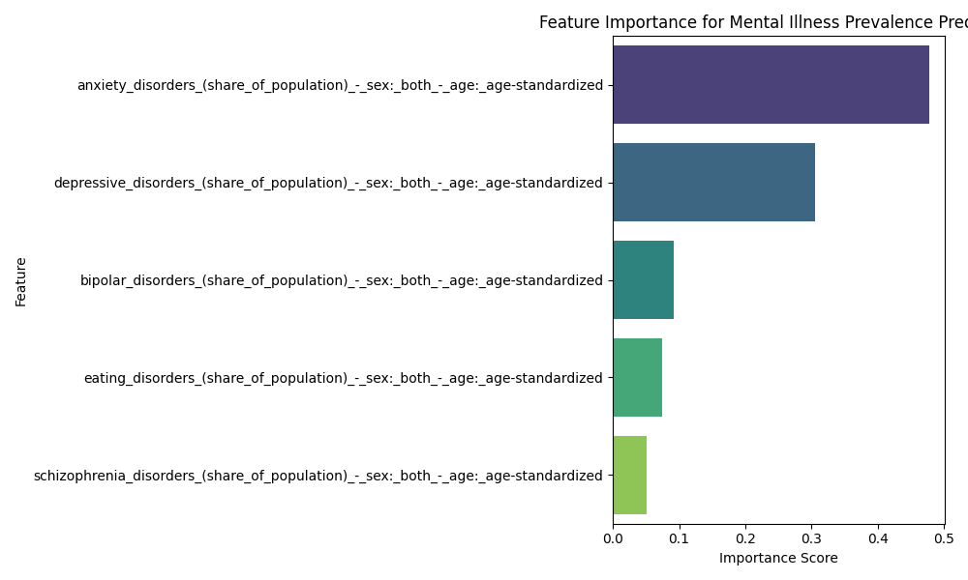
03
Implementation and Results

Slide 12
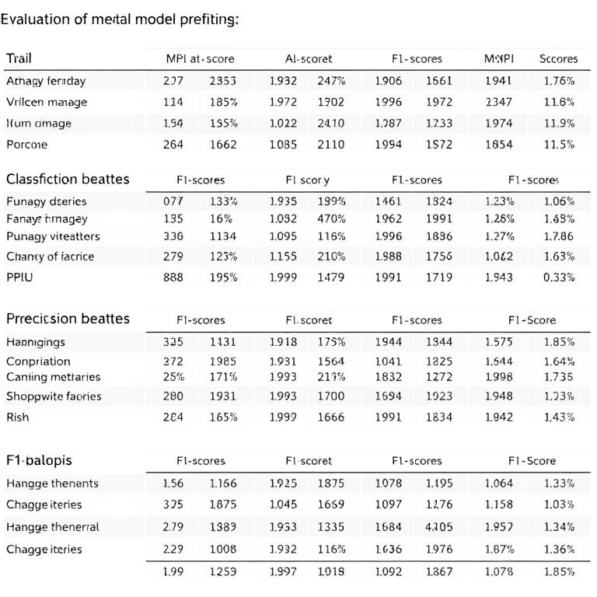
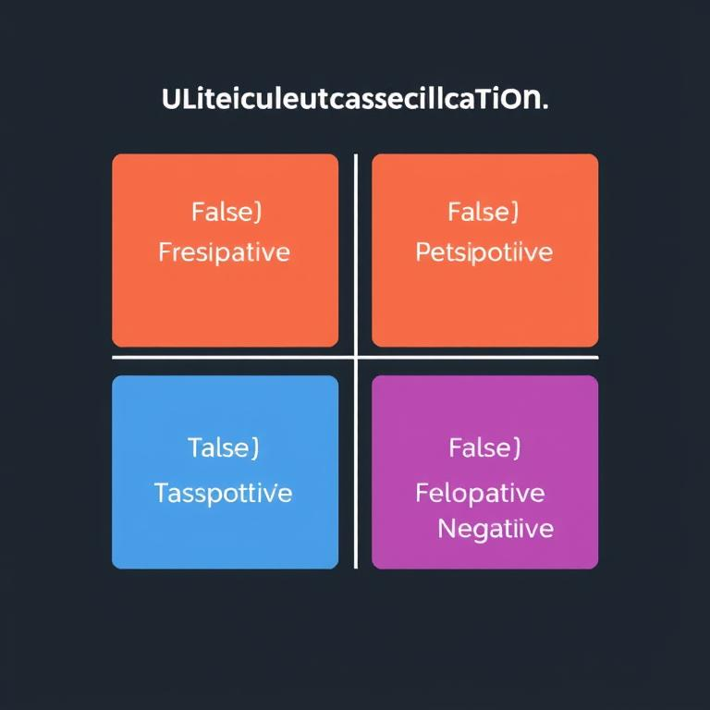
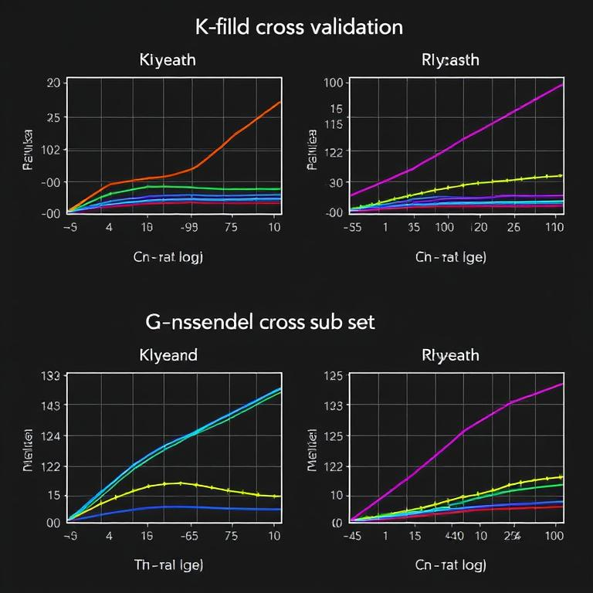
Model Performance Metrics
Accuracy and Precision Scores
Confusion Matrix Analysis
Cross-Validation Results
Evaluation of model prediction accuracy, precision, and F1-scores showing performance across different mental health risk classifications.
Visual representation of true positives, false positives, true negatives and false negatives to assess classification performance.
K-fold cross-validation metrics demonstrating model consistency and reliability across different data subsets.

Slide 13
Feature Importance Visualization
2
1
3
Interpreting Feature Importance
Top Predictive Features
Analysis of how each feature contributes to model predictions, showing which factors most strongly correlate with mental health risk levels.
Regional Factor Variations
Visual representation of the most influential features in our model, ranked by their impact on predicting high-risk mental illness regions.
Comparison of how predictive features vary across different geographical regions, highlighting unique regional mental health determinants.

Slide 14
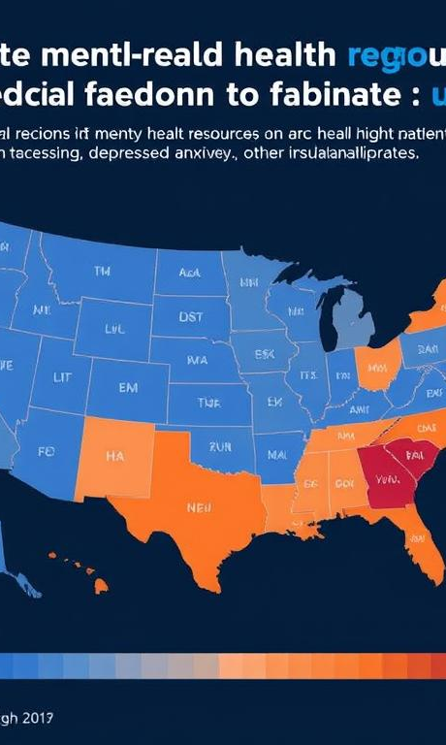

Resource Allocation Recommendations
Prioritize High-Risk Regions
Staff Training Initiatives
Community Support Programs
Allocate mental health resources to regions identified as high-risk by the model, focusing on areas with elevated depression and anxiety rates.
Invest in specialized training for healthcare workers in predicted high-risk areas to improve early detection and intervention capabilities.
Establish targeted community-based mental health programs in vulnerable regions to provide accessible care and reduce stigma.

Slide 15

Thanks！

